Slide 1
Why Pakistan Struggles to Build Tech Giants: Investigating the Role of University Education A Student Perspective Authors: Umair Solangi, Hamza bin Jawed Department: Computer Science, SZABIST Karachi How effectively does university education in Pakistan equip computer science graduates with the practical skills and knowledge required to develop scalable tech products, and what are the key gaps between academic training and industry demands?

Slide 2
Introduction
Problem Statement:
Pakistan produces thousands of CS graduates yearly, but few contribute to global tech innovation.
Universities focus on outdated curricula, lack industry alignment, and provide minimal practical exposure.
Objective:
Evaluate CS education quality through student perspectives.
Identify gaps in curriculum, faculty, internships, and entrepreneurship support.

Slide 3
Research Questions
Is the CS curriculum aligned with industry needs?
Do students receive adequate practical training?
Are faculty members industry-experienced?
How accessible are internships and entrepreneurial support?
Are there differences between public (NED) and private (SZABIST) universities?

Slide 4
Literature Review: Key Sources
1. HEC (2021): Curriculum lacks consistent implementation, weak enforcement.
2. P@SHA & PSEB (2022): Only 18% trained in modern tech; big skill gaps.
3. World Bank (2020): Weak R&D, outdated education, poor public-private ties.
4. British Council (2019): Only 23% employable; missing soft skills, hands-on learning.
5. Stack Overflow (2023): 42% self-taught DevOps; rising informal learning trend.

Slide 5
Literature Review: Summary & Gaps
• Universities still teach outdated tech with few updates.
• Curricula designed without industry input; AI, Cloud, DevOps missing.
• Faculty lack industry experience; mostly theory-based teaching.
• Students miss hands-on learning, internships, and startup exposure.
• Most studies ignore student voices — this research fills that gap.

Slide 6
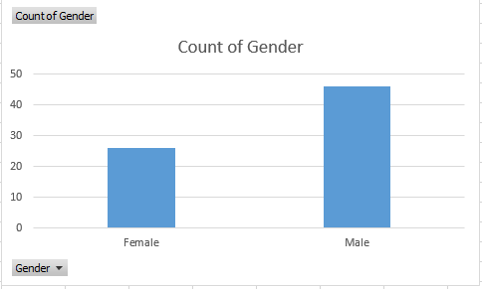
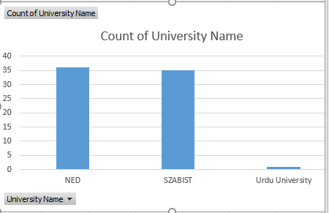
Methodology
Sample: 72 final-year CS students (NED: 52, SZABIST: 19, Urdu University: 1).
Data Collection: Structured survey (Likert scales, multiple-choice, open-ended questions).
Analysis: Descriptive statistics, comparative analysis (NED vs. SZABIST).

Slide 7
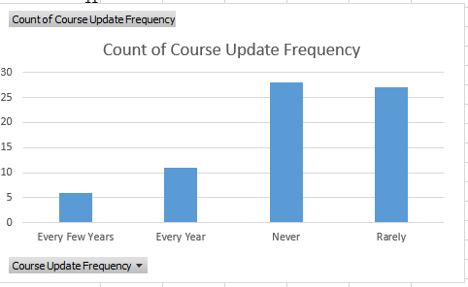
Key Findings (Curriculum)
Outdated Content: 65% report rare/never updates.
Low Relevance: Avg. rating 2.8/5 for job market alignment.
SZABIST vs. NED: SZABIST rated higher (3.1 vs. 2.7).
Student Demand: AI, Blockchain, DevOps missing.

Slide 8
Key Findings (Faculty & Teaching)
Faculty Industry Experience: Avg. 3.1/5.
Theory-Heavy: 75% say lectures lack practical labs.
SZABIST Advantage: Faculty rated more helpful (3.4 vs. 3.1).

Slide 9
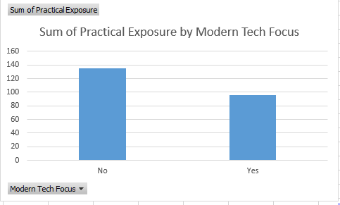
Key Findings (Practical Exposure)
Git Proficiency: Avg. 2.7/5 (60% rate themselves ≤3).
Internships: 53% completed, but only 55% aligned with studies.
University Support: 58% received help; 42% found none.

Slide 10
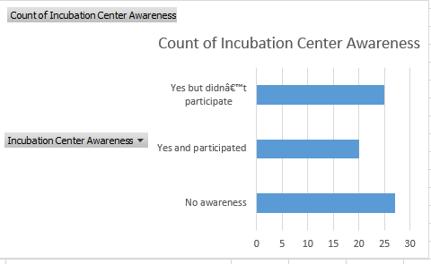
Key Findings (Entrepreneurship & Confidence)
Low Confidence: Avg. 4.6/10 in job readiness.
Startup Support: Only 15% tried launching a startup; 47% aware of incubators.
Barriers: Lack of funding, mentorship, and risk-averse culture.

Slide 11
NED vs. SZABIST Comparison
Metric | NED | SZABIST
Curriculum Relevance | 2.7 | 3.1
Faculty Industry Exp. | 3.0 | 3.3
Internship Support | 55% | 63%
Confidence (1-10) | 4.4 | 5.1

Slide 12
Recommendations (Curriculum)
Annual Updates: Integrate AI, Cloud, DevOps.
Industry Collaboration: Involve tech firms in syllabus design.
Project-Based Learning: Replace rote exams with real-world projects.

Slide 13
Recommendations (Faculty & Training)
Hire Industry Professionals: Prioritize faculty with coding experience.
Faculty Upskilling: Sponsor certifications/workshops.
Hands-On Labs: Modernize labs with Git, CI/CD, cloud platforms.

Slide 14
Recommendations (Entrepreneurship & Careers)
Expand Incubators: Funding, mentorship, networking.
Mandatory Internships: Partner with companies for placements.
Career Centers: Resume workshops, mock interviews, job fairs.

Slide 15
Conclusion
Universities must bridge the gap between academia and industry.
Urgent reforms needed in curriculum, faculty training, and practical exposure.
Stronger industry partnerships can boost graduate employability and innovation.

